Slide 1

CYBER SECURITY
Santosh Kumar Kar
santosh.kar@braneenterprises.com
http://www.santoshkumarkar.com

Slide 2
What are we going to cover
Cyber-security and Cyber Attacks
Types of Cyber Threats
Hackers vs Ethical Hackers
Types of Hackers

Slide 3
Cyber Security
Practice of protecting from digital attacks
Systems
Networks
Programs
Database
Cyber Attack
Aimed at accessing, changing, or destroying sensitive information
Extorting money from users via ransomware
Interrupting normal business processes.

Slide 4
Overview of Cybersecurity Threats
Phishing
Social engineering
Ransomware
Malware
Phishing & Social Engineering
Denial of Service (DoS, DDoS)
Man-in-the-Middle (MitM)

Slide 5
Malware
Short for "malicious software“
Designed to harm or exploit computer systems, networks, or users
Types of malware
Viruses
Worms
Trojan Horses
Ransomware
Spyware
Adware
Keyloggers
Botnets

Slide 6
Some common attacks
Viruses
A malware that can spread from one machine to another machine by attaching itself to a legitimate program or file
Trojans
Malware that disguises itself as legitimate software but gives hackers access to a user’s computer
Ransomware
A type of malware that encrypts a user’s files and demands payments in exchange for the decryption key
Adware
A type of malware that displays unwanted ads or pop-ups on a user’s computer
Cyber Scams and Frauds
Identity Theft

Slide 7
Phishing and Social Engineering
Trick where hackers pretend to be trustworthy and ask you for private information like passwords or credit card numbers
Emails, messages, or websites that look real
Calls

Slide 8
Security Principles for developers

Slide 9
Security Principles for Developers
Developers play a critical role in building secure software and applications. By adhering to security principles during the development process, they can help prevent vulnerabilities, protect user data, and ensure the overall integrity of their creations. Here are key security principles that developers should follow:
1. Input Validation and Sanitization:
Always validate and sanitize user inputs to prevent attacks like SQL injection, cross-site scripting (XSS), and command injection.
Use parameterized queries or prepared statements for database interactions to avoid SQL injection vulnerabilities.
Implement output encoding to prevent XSS attacks by converting user inputs into safe HTML entities.
2. Authentication and Authorization:
Implement strong authentication mechanisms, such as multi-factor authentication (MFA), to ensure that only authorized users can access resources.
Utilize secure session management practices to maintain user sessions securely.
Implement role-based access control (RBAC) to ensure that users only have access to the resources they need.
3. Secure Coding Practices:
Follow secure coding guidelines provided by your programming language and platform.
Avoid hardcoding sensitive information like passwords and API keys in your code.
Regularly review your code for vulnerabilities and apply best practices for error handling and logging.
4. Data Protection and Encryption:
Use encryption algorithms to protect sensitive data both at rest and during transit.
Implement encryption protocols such as TLS/SSL to secure communications over the network.
Encrypt passwords using strong hashing algorithms and apply salt to prevent password cracking.
5. Secure Dependencies and Libraries:
Keep third-party libraries and dependencies up to date to avoid known vulnerabilities.
Use reputable sources for libraries and ensure they are well-maintained.
Consider using tools that automatically check for vulnerabilities in your dependencies.
6. Avoid Common Vulnerabilities:
Be aware of common vulnerabilities like buffer overflows, race conditions, and insecure deserialization.
Keep yourself informed about the latest security threats and vulnerabilities affecting your technology stack.
7. Security Testing:
Regularly conduct security testing, including penetration testing and code reviews, to identify and fix vulnerabilities.
Implement unit testing, integration testing, and security testing as integral parts of your development process.
8. Error Handling and User Feedback:
Provide informative error messages to developers for debugging purposes but avoid exposing sensitive information to end-users.
Ensure that user error messages do not provide attackers with information about the system's vulnerabilities.
9. Implement Content Security Policies (CSP):
Utilize CSP to mitigate risks associated with cross-site scripting (XSS) attacks by controlling which resources are loaded.
10. Regular Updates and Patch Management:
Keep all software components up to date, including libraries, frameworks, and your application code.
Address security vulnerabilities promptly by applying patches and updates as soon as they become available.
11. Threat Modeling:
Implement threat modeling during the design phase to identify potential security threats and design mitigations.
Consider potential attack vectors and prioritize security measures accordingly.
12. Education and Training:
Continuously educate developers about secure coding practices and the latest security threats.
Promote a culture of security awareness among the development team.
By integrating these security principles into the development process, developers can contribute significantly to the creation of secure and resilient software applications that protect user data, maintain user trust, and safeguard against potential cyber threats.

Slide 10
Top Social Engineering Attacks
2022 Attack on Uber
2016 US Presidential Election Email Leak
2020 Twitter Bitcoin Scam
2022 Attack on Rockstar Games
2022 Attack on Twilio

Slide 11

Types of Hackers

Slide 12
Black Hat Hacker
Imagine these hackers as the "bad guys" of the digital world.
They break into computer systems and networks without permission, often for personal gain or to cause harm.
Their actions can lead to stolen data, financial loss, and disruptions to services.

Slide 13
White Hat Hackers:
The Ethical Hacker
Think of these hackers as the "good guys" who wear a cybersecurity cape.
security experts who hack networks, applications, or any resource with the permission of respective owners.
Their goal is to help organizations fix weaknesses and prevent cyberattacks.

Slide 14
Difference Between Hacking and Ethical Hacking
Aspect | Hacking | Ethical Hacking
Intent | Unauthorized access, harm | Authorized, security
Authorization | Unauthorized | Authorized by owner
Methodology | Exploiting vulnerabilities | Identifying vulnerabilities
Skills | Technical expertise | Technical + ethical
Collaboration | Often independent | Collaborates with orgs
Outcomes | Breach, data theft | Vulnerability discovery
Ethical Consideration | Often disregarded | Follows ethical code
Benefits | Often harmful | Strengthened security

Slide 15
Grey Hat Hackers:
These hackers fall somewhere in between black hats and white hats.
They might identify vulnerabilities without permission but then notify the system owners to fix them.
Their actions can be a bit ambiguous, as they sometimes cross ethical boundaries

Slide 16
Script Kiddies:
Novice hackers who use pre-made tools and scripts without really understanding how they work.
They might not have deep technical knowledge, and their actions are often more annoying than seriously harmful.
They might copy and paste code from the internet to do digital pranks, kind of like doing magic tricks with a trick book

Slide 17
Hacktivists
Hackers who use their computer skills to raise awareness about important issues.
They might use hacking techniques to show their support for a cause, kind of like creating online banners for a protest
Hacktivists use their talents to grab attention in the digital world and make their message heard.

Slide 18
State-Sponsored Hackers:
These are hackers who work on behalf of a government or a state entity.
They often engage in cyber espionage, stealing sensitive information from other countries or organizations.

Slide 19
Cybercriminals
Cybercriminals are hackers who are in it for financial gain.
They might steal credit card information, engage in identity theft, or carry out ransomware attacks to demand money.

Slide 20
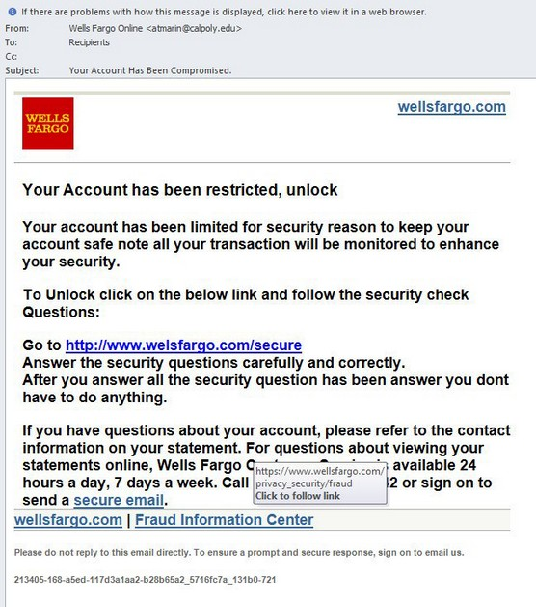
1

Slide 21
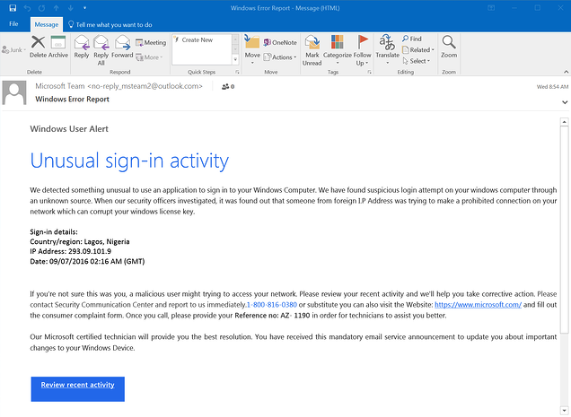
2

Slide 22
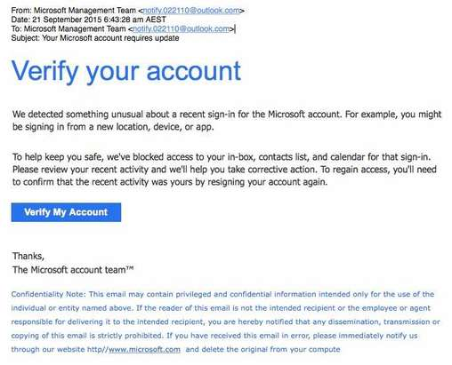
3

Slide 23
SET - Social-Engineer Toolkit
Open-source software framework used for performing various types of social engineering attacks
Designed to help security professionals and penetration testers simulate social engineering attacks to identify vulnerabilities in their organization's security systems.

Slide 24
Cybercrime against individuals

Slide 25
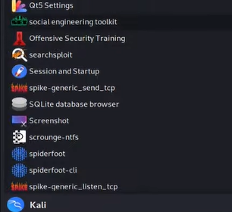
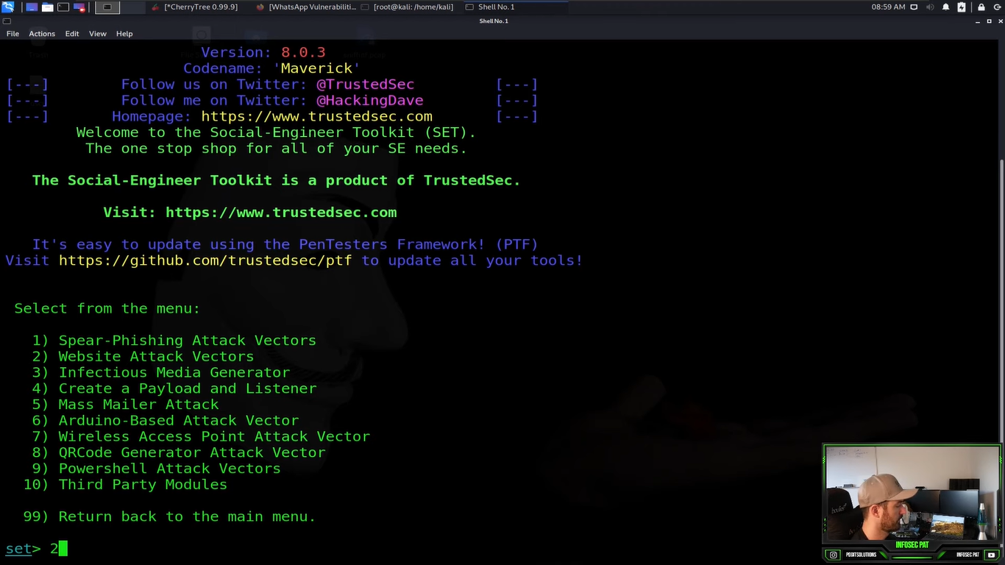
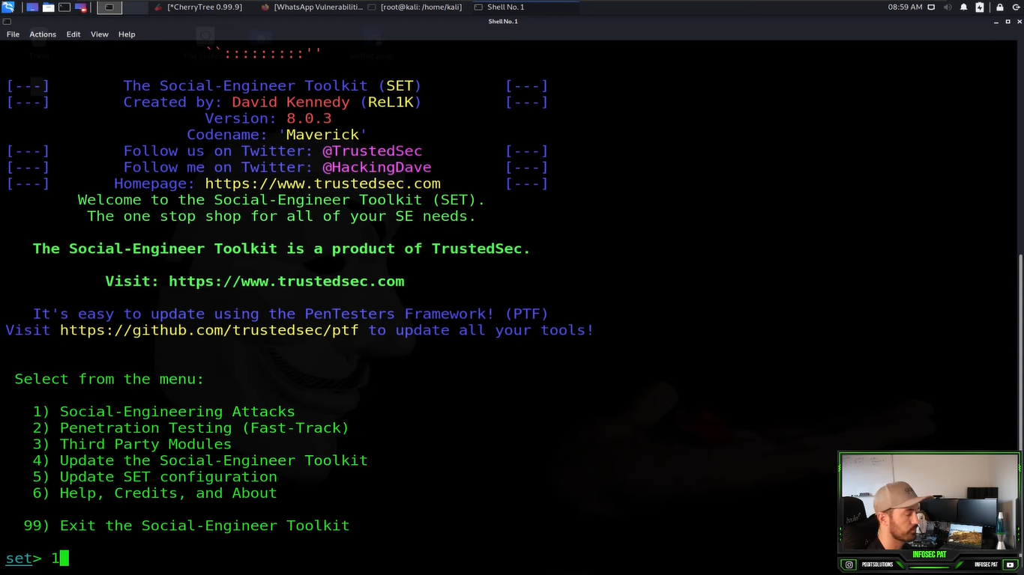
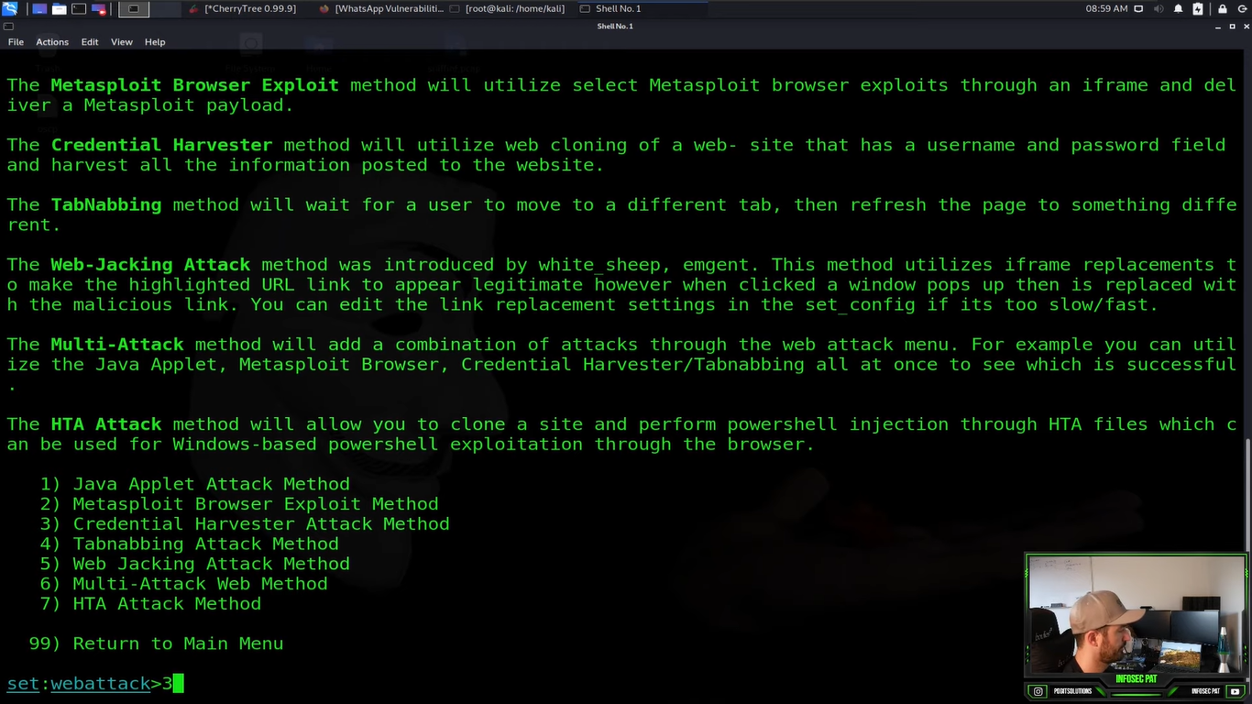
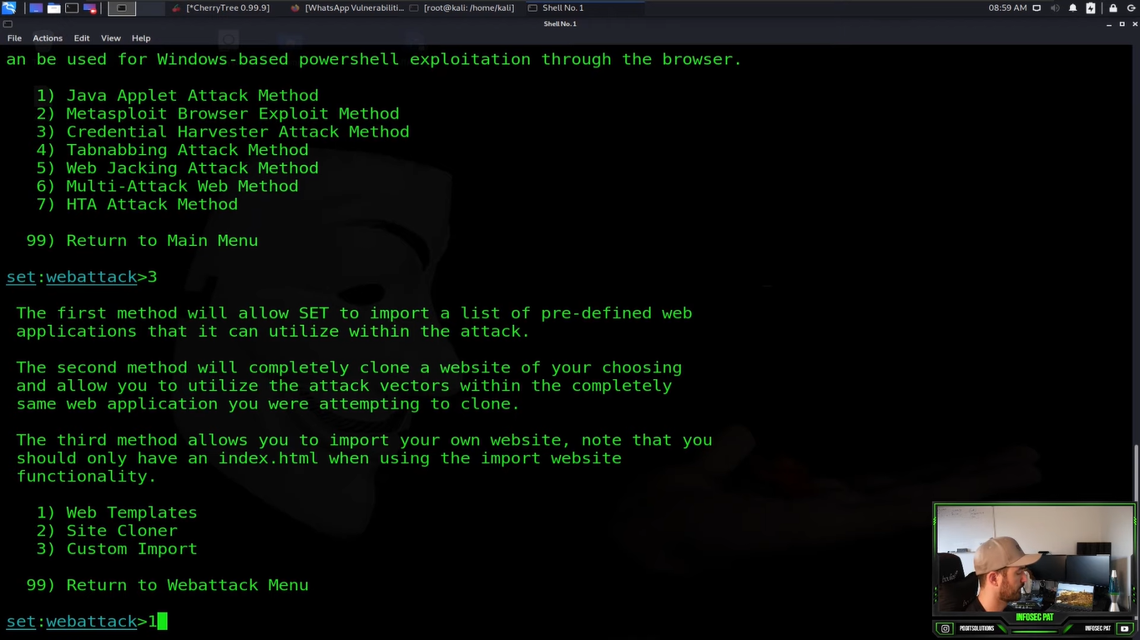
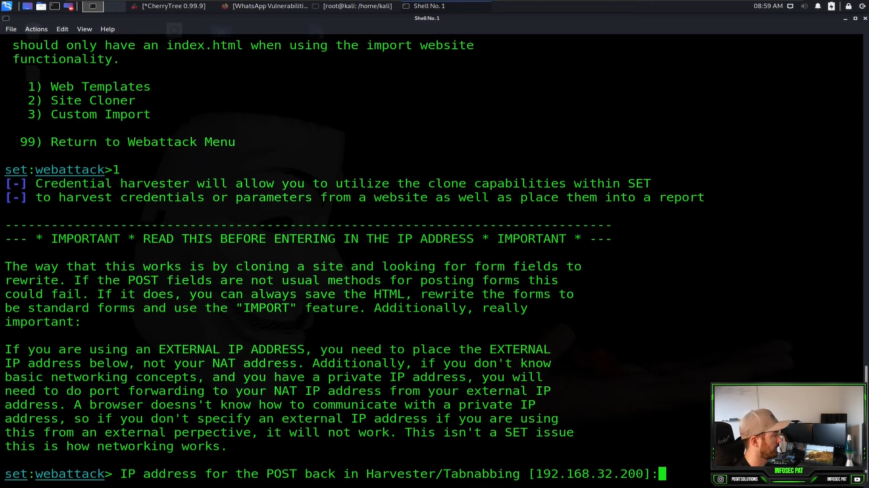
2
1
3
5
4
6

Slide 26
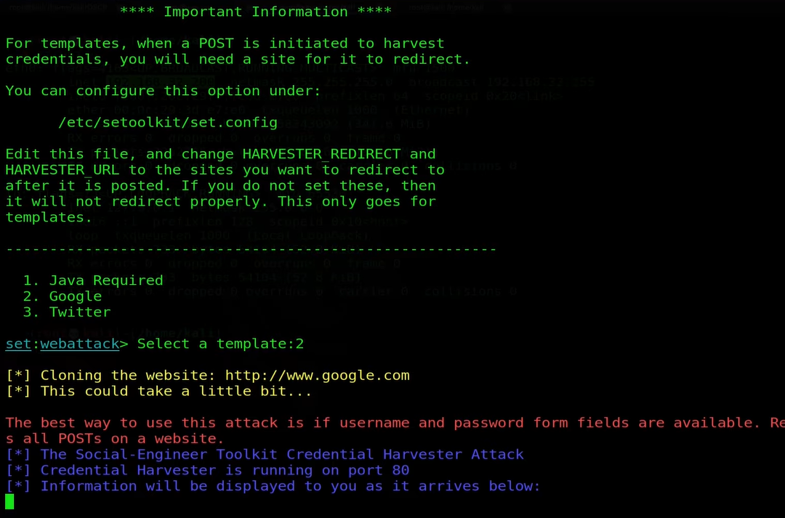

Slide 27
Victim’s Email

Slide 28
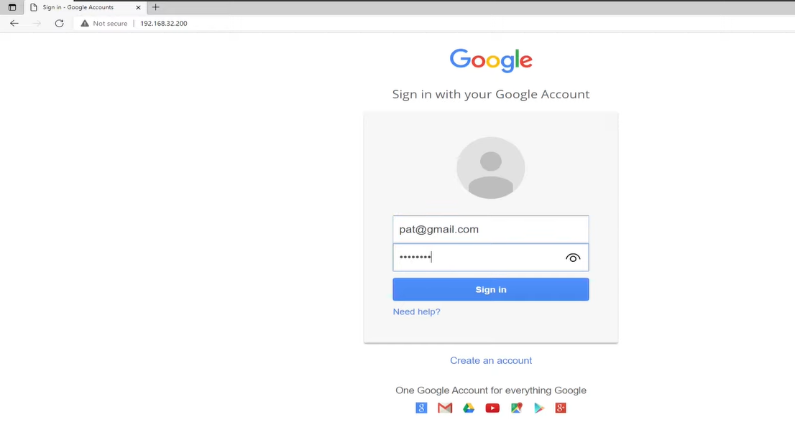
Victim’s desktop

Slide 29
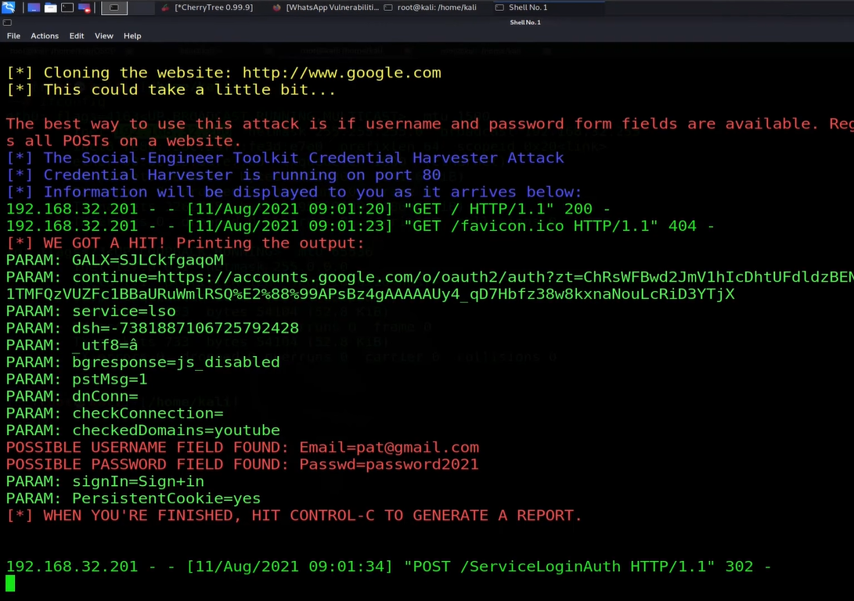

Slide 30
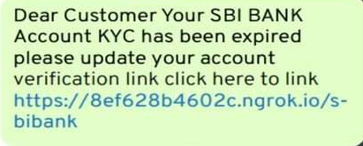
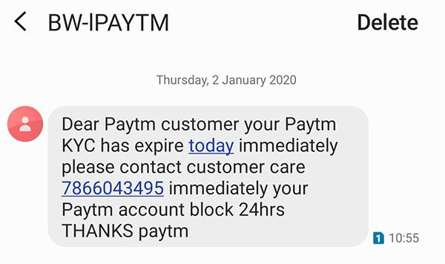
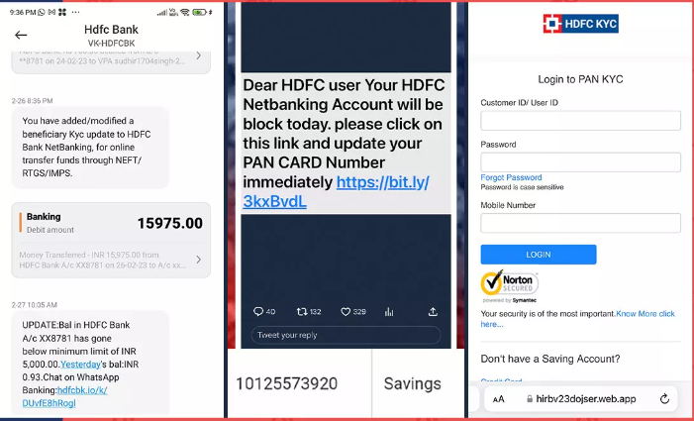
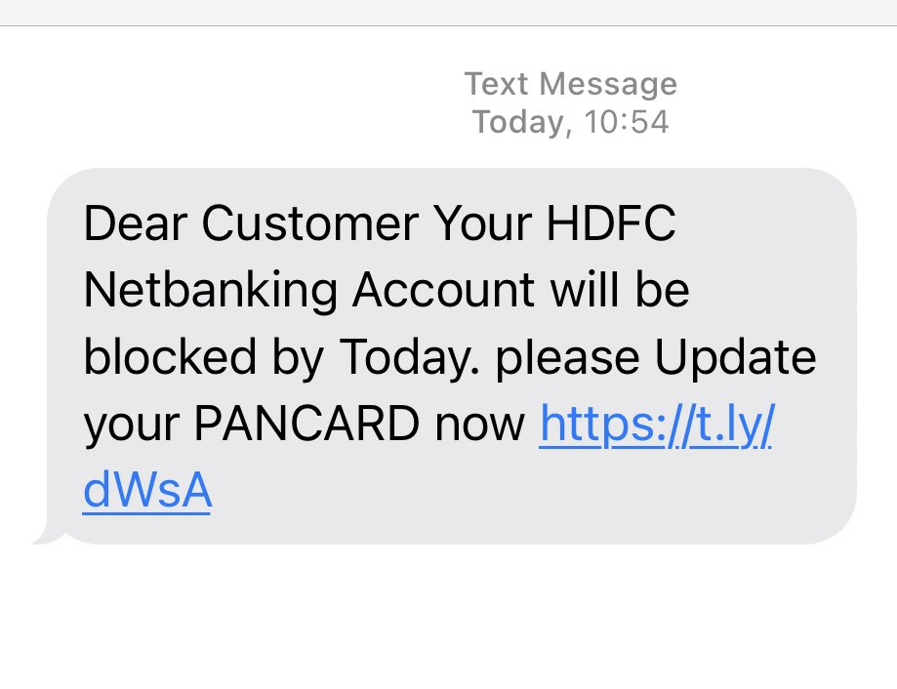
Man tricked by a fake KYC message, lost more than 8 lakh after he clicked on a suspicious link
KYC update fraud: Udupi resident loses ₹3.9 lakh

Slide 31
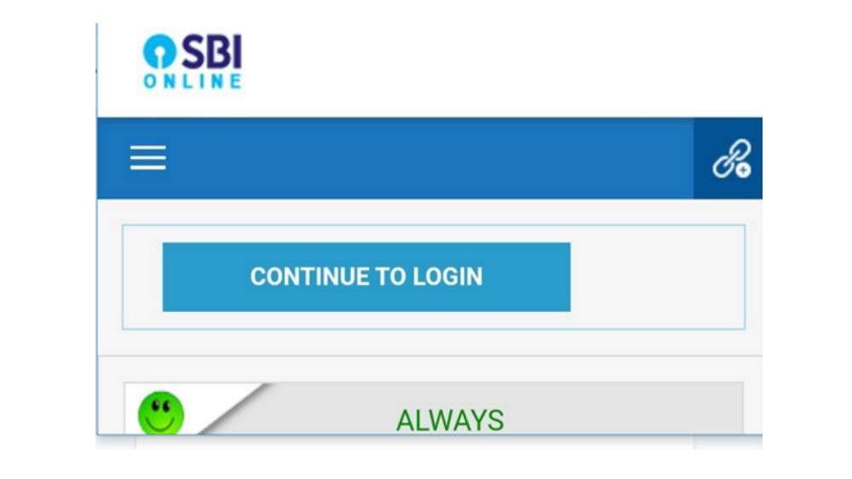
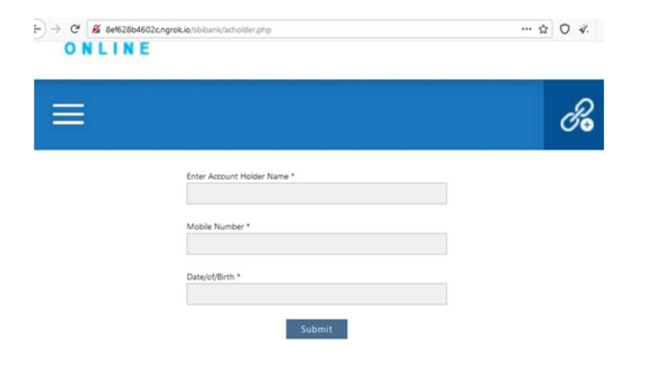
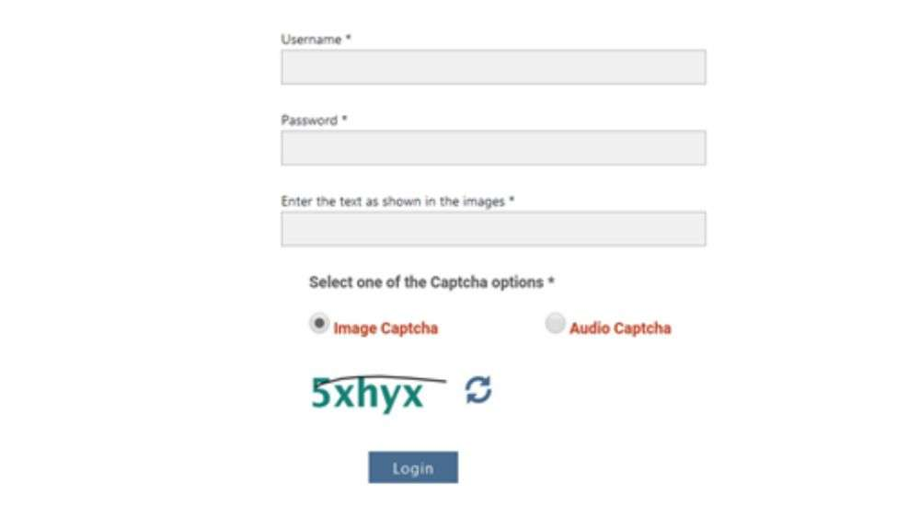
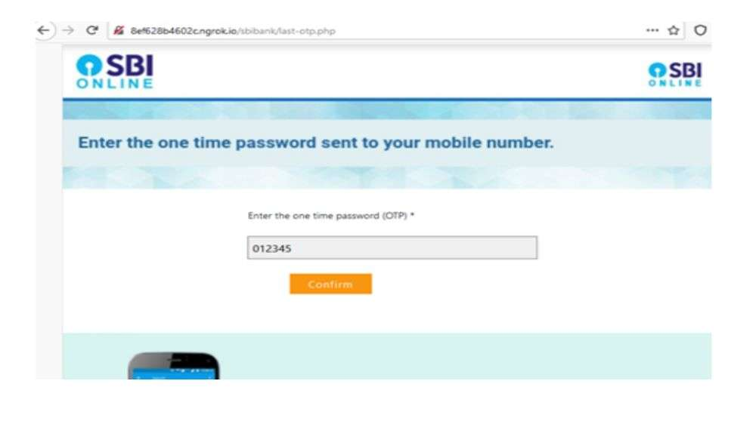

Slide 32
fraud-call.html

Slide 33
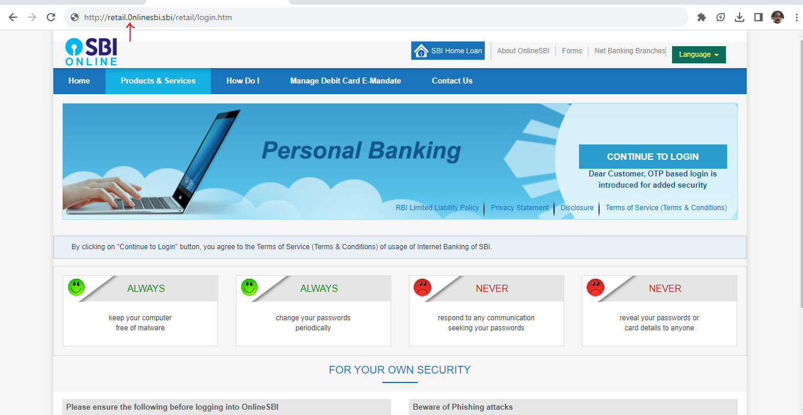

Slide 34
Identifying Scam Websites
Suspicious URLs
Look for a lock (Legitimate SSL/TLS certificates)
Half of all Phishing Sites Now Have the Padlock
see the domain in the certificate details, which would reveal the website’s actual domain (details>subject)
Check the domain age
Poor Design and Content Unsecured Connections
Unrealistic Offers
Limited Contact Information
Use a website checker - Google’s Safe Browsing Site Status tool

Slide 35
How to protect yourself against cybercrime
Use a secured internet connection
Use Anti-virus
Be cautious with unsolicited emails, text messages and phone calls
Don’t save passwords as urged by browsers
Use strong passwords
Keep your software updated
Manage your social media settings
Strengthen your home network
strong encryption password + VPN (virtual private network)
Keep an eye on the kids

Slide 36

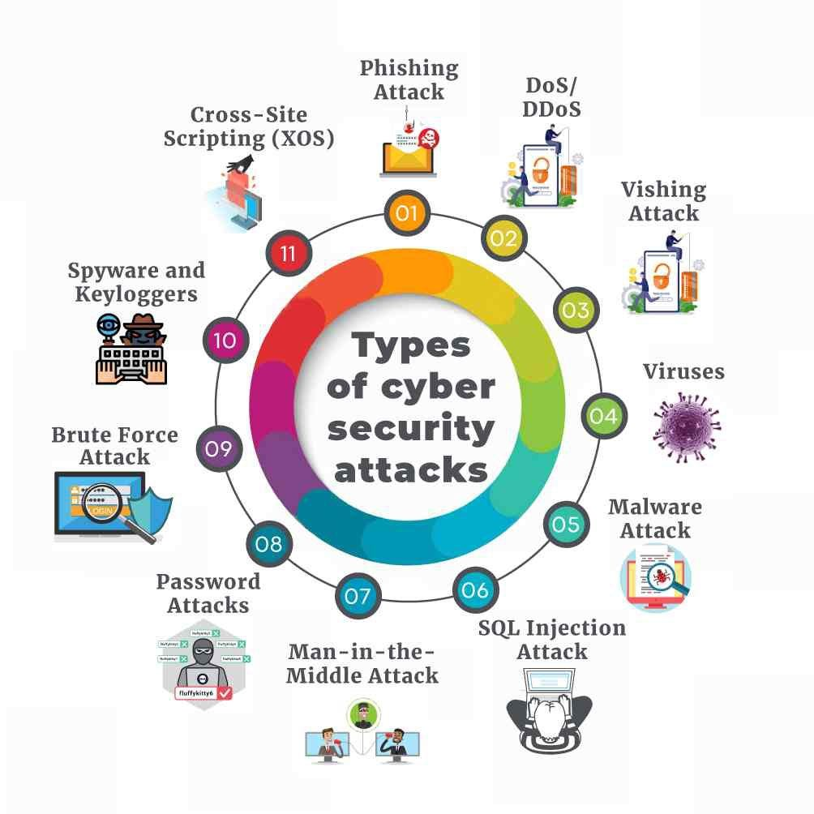

Slide 37
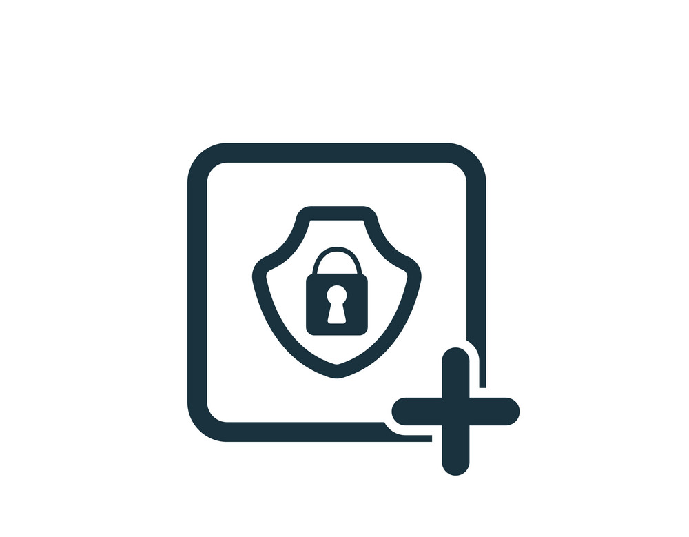
Secure Coding Secure application development

Slide 38

Risk assessment and vulnerability assessment
1

Slide 39

1. Identify Assets:
Customer Data
Personal information, contact details, and payment information of customers
Infrastructure and Network
Regulatory Compliance Data
Database and Data Repositories
Network Infrastructure
Cloud Infrastructure
Frameworks & Libraries

Slide 40
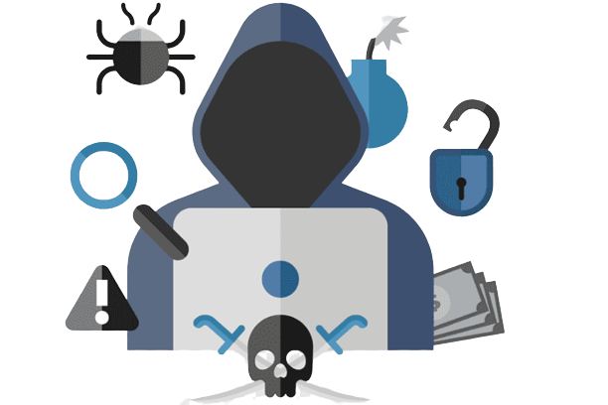
2. Identify Threats:
Customer Data:
Threats: Data breaches, unauthorized access, identity theft, phishing attacks.
Infrastructure and Network:
Threats: Unauthorized access, DDoS attacks, malware infections.
Regulatory Compliance Data:
Threats: Unauthorized access, non-compliance, data breaches.
Database and Data Repositories:
Threats: SQL injection, data breaches, insider attacks.
Network Infrastructure:
Threats: Hacking, unauthorized access, malware propagation.
Cloud Infrastructure:
Threats: Data breaches, cloud misconfigurations, loss of control.
Frameworks & Libraries:
Threats: Software vulnerabilities, hacking, data leaks.

Slide 41
2. Risk Assessment - Evaluating the potential impact
Customer Data
Impact: High (sensitive information) / Likelihood: Moderate (common target for attackers)
Risk Level: High (Implement strong encryption, access controls, and monitoring).
Regulatory Compliance Data
Impact: High (legal penalties, reputation damage) / Likelihood: Moderate (targeted attacks)
Risk Level: High (Implement encryption, access controls, and compliance measures).
Database and Data Repositories
Impact: High (data breaches, business impact) / Likelihood: High (common vulnerabilities)
Risk Level: High (Implement encryption, access controls, and regular vulnerability assessments).
Network Infrastructure
Impact: High (data breaches, service disruption) / Likelihood: High (constantly targeted)
Risk Level: High (Implement strong firewalls, intrusion detection, and network segmentation).
Cloud Infrastructure
Impact: High (data breaches, loss of control) / Likelihood: Moderate (misconfigurations, targeted attacks)
Risk Level: High (Implement proper access controls, encryption, and ongoing monitoring).
Frameworks & Libraries
Impact: High (data breaches, compromised functionality) / Likelihood: High (common vulnerabilities)
Risk Level: High (Implement secure coding practices, regular code reviews, and penetration testing).

Slide 42
Treatment of Risks
Customer Data:
Treatment: Implement strong encryption, access controls, and regular monitoring.
Mitigation: Encrypt sensitive data at rest and during transmission, restrict access based on roles, and monitor for unauthorized activity.
Regulatory Compliance Data:
Treatment: Implement encryption, access controls, and compliance measures.
Mitigation: Encrypt sensitive data, restrict access based on compliance requirements, and follow relevant industry regulations.
Database and Data Repositories:
Treatment: Implement encryption, access controls, and regular vulnerability assessments.
Mitigation: Encrypt stored data, use strong access controls, and regularly assess vulnerabilities in the database.
Network Infrastructure:
Treatment: Implement strong firewalls, intrusion detection, and network segmentation.
Mitigation: Set up firewalls to filter network traffic, use intrusion detection systems to monitor for threats, and segment networks to limit lateral movement.
Cloud Infrastructure:
Treatment: Implement proper access controls, encryption, and ongoing monitoring.
Mitigation: Configure access controls for cloud resources, encrypt sensitive data, and continuously monitor cloud security configurations.
Frameworks & Libraries
Treatment: Implement secure coding practices, regular code reviews, and penetration testing.
Mitigation: Train developers in secure coding, conduct regular code reviews for vulnerabilities, and perform penetration testing to identify weaknesses.

Slide 43
TODO:
Ref: https://www.udemy.com/share/102TrA/
https://www.ipqualityscore.com/documentation/overview

Slide 44
https://www.invicti.com/blog/web-security/sql-injection-cheat-sheet/
https://www.invicti.com/learn/session-hijacking/
https://www.invicti.com/blog/web-security/session-hijacking/

